Slide 1
Computer Graphics HW: 3D Maze Texture
Deadline: June 6, 2023

Slide 2
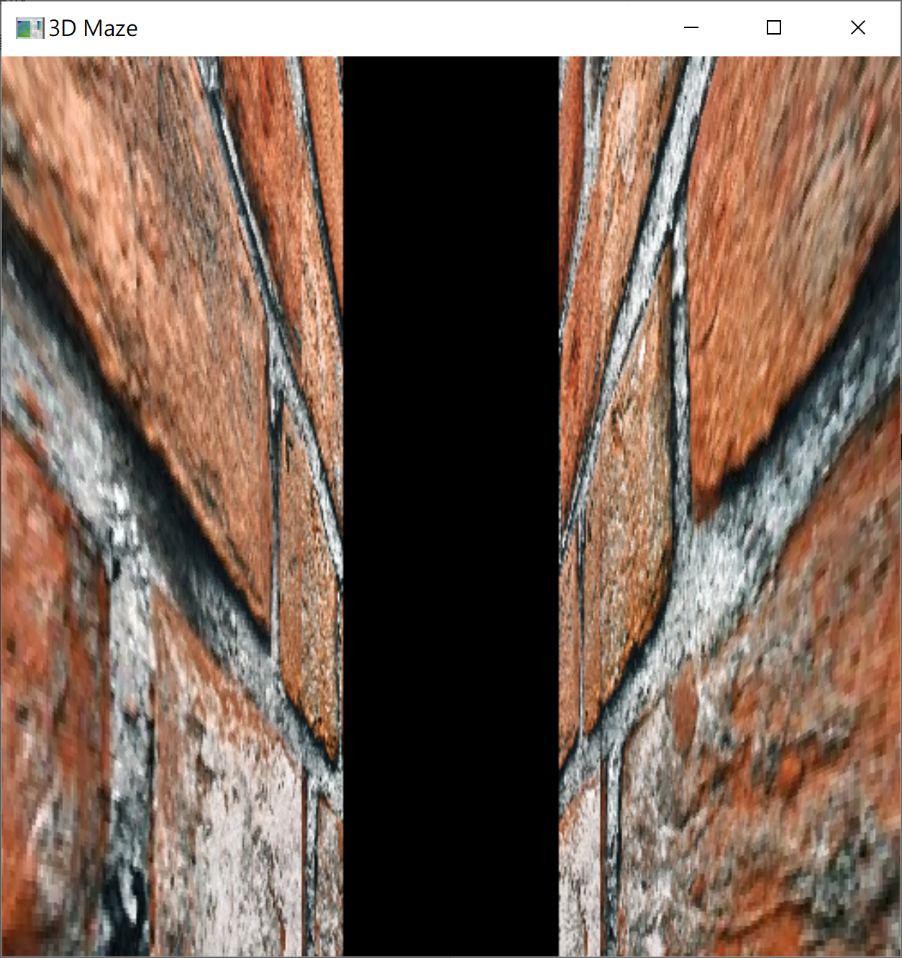
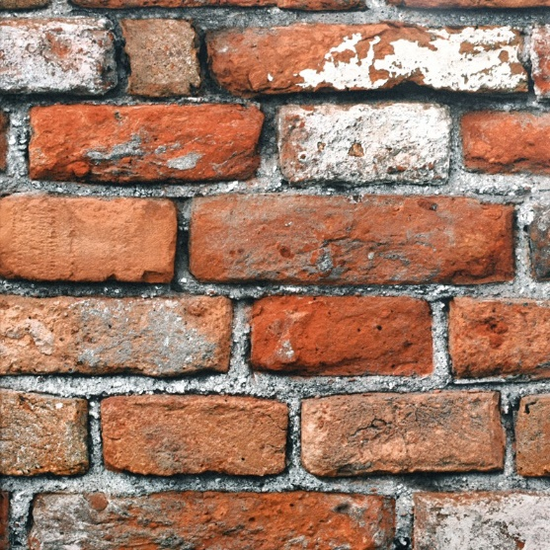
Requirement
3D Maze Construction
add texture to your maze

